Slide 1
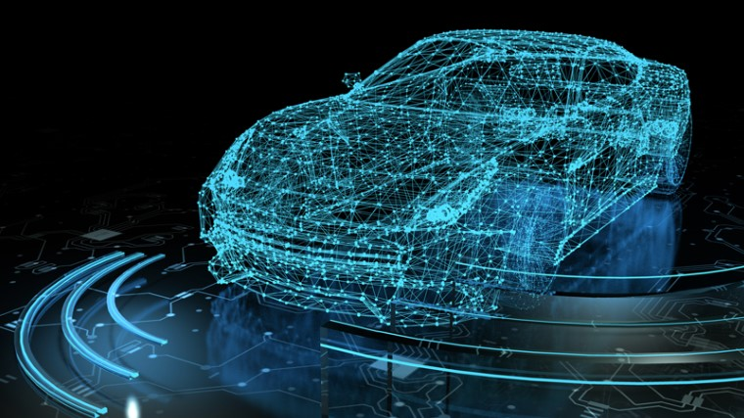
SELF DRIVING CAR
- Futuristic self
- Komal Reddy Koukuntla

Slide 2
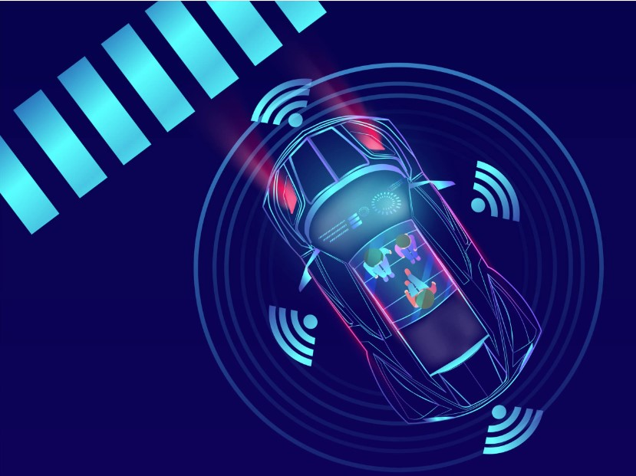
ABSTRACT
Self-Driving car, a car capable of sensing its surrounding and moving on its own through traffic and other obstacles with minimum or no human input. This is the current upcoming technology in the automobile industry and even though it has been discussed and worked on for a long time, it was successfully manufactured by TESLA. In recent years, these cars began to roll out in foreign markets as private and public vehicles(taxis etc.). Many companies like Waymo, UBER, Nissan, Nvidia are involved in this product development. With this type of car, the whole automotive transportation's safety, security, efficiency is increased and the human errors can be eradicated whilst the drive is made to its best. This project has infused the idea of traffic signal resposding which is absent in the current models and the above mentioned advantages can be achieved with much more ease and at a low cost. This type of system can bring a revolution in transporting for differently abled people and also help blind people travel independently.

Slide 3
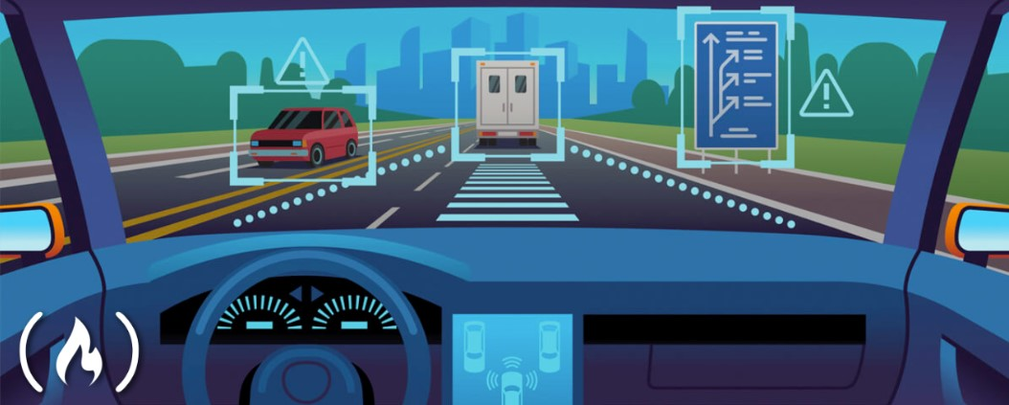
OBJECTIVE
Demonstrate automated driving in complex traffic environments. Test integrated applications in all possible scenarios taking into account the full range of automation levels.
Enhance the perception performance in complex scenarios by using advanced sensors supported by cooperative and communication technologies.

Slide 4
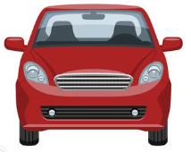
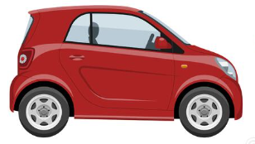
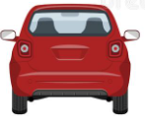
INTRODUCTION
When we manually drive a car we see front at first then at back(rear) if required, and also we look at the side view mirrors, these images act as inputs
Rear view
Front view
Side view

Slide 5
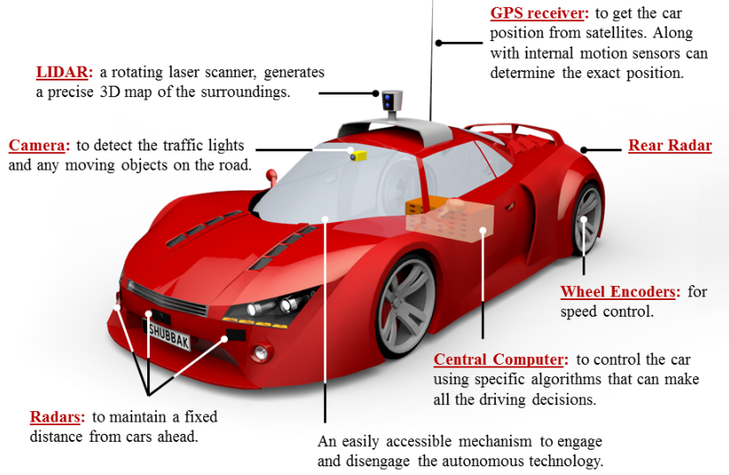
Input will be given by cameras(Front view, Rear view, Side view)
LIDAR(3D Geometry, little expensive)
RADAR(how far the object is)
Ultrasonic sensors
GPS
Depending on company to company we can have as many inputs as possible

Slide 6
How these inputs exactly work?
The inputs defined before are sent to computing box
This computing box gives us the outputs
OUTPUTS FOR DRIVING CAR
Steering wheel angle
Acceleration we need to apply
Brakes if required
Indicators or signals which are needed to be handled properly

Slide 7
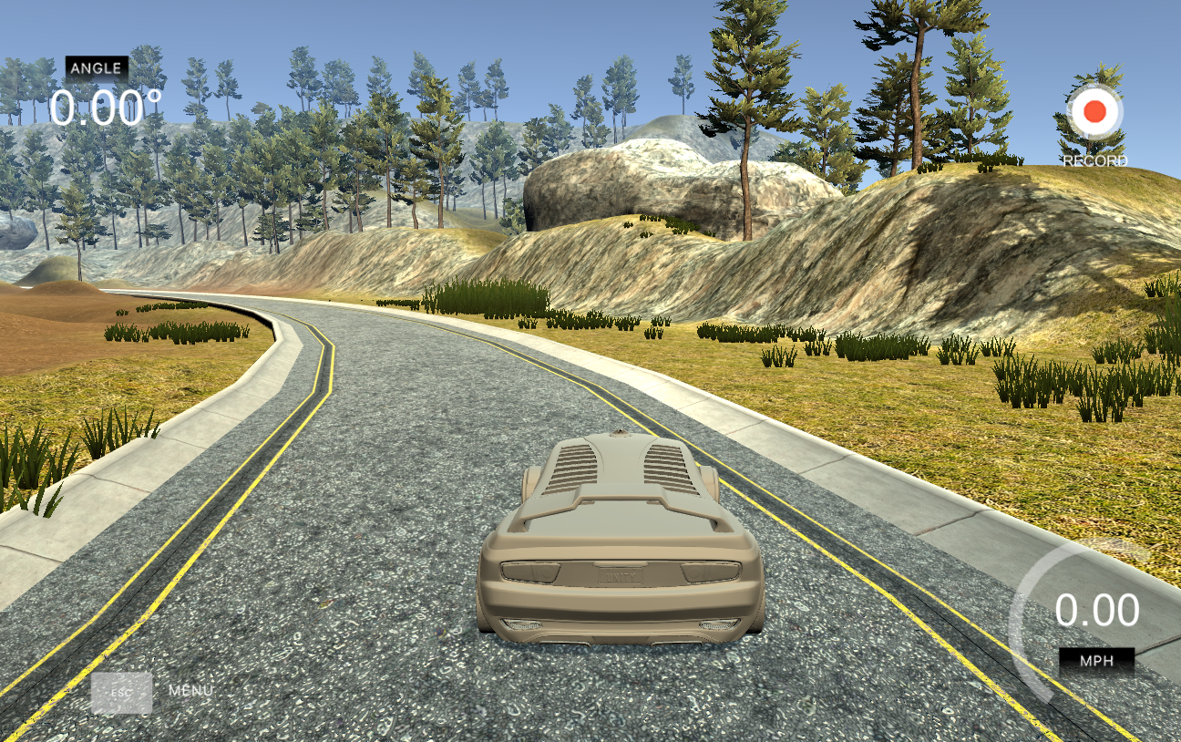
Data Generation
Records images from center, left, and right cameras w/ associated steering angle, speed, throttle and brake.
Saves to CSV
Ideally you have a joystick, but keyboard works too
Udacity recently open sourced their self driving car simulator originally built for SDND students
Built in Unity
Added a bunch of scripts like gravity, momentum and acceleration

Slide 8
Training Mode- Behavioural cloning
We use a 9 layer convolutional network(in keras its literally 9 lines of code), based off of Nvidia's end-to-end learning for self driving car paper. 72 hours of driving data was collected in all sorts of conditions from human drivers
How is data organized in CSV File?
First three columns are images captured by center , left , right cameras respectively
Next four columns are steering angle, throttle,reverse,speed respectively
We split the data into training part of 80% and testing part of 20%

Slide 9
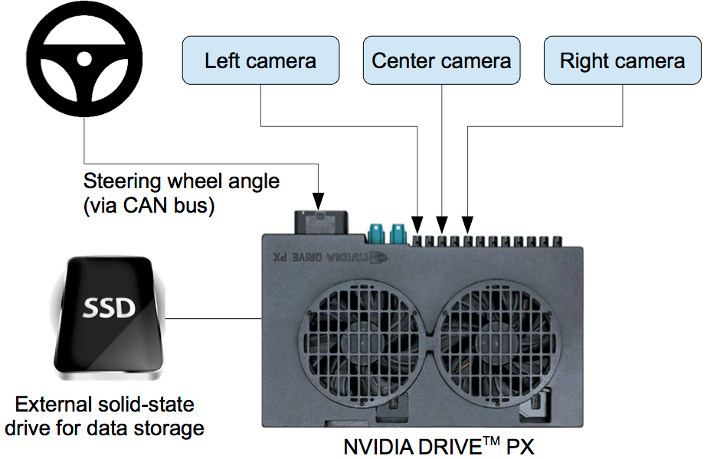
METHODOLOGY
Hardware design
3 cameras
The steering command is obtained by tapping into the vehicle’s Controller Area Network (CAN) bus.
Nvidia's Drive PX onboard computer with GPUs
In order to make the system independent of the car geometry, the steering command is 1/r, where r is the turning radius in meters. 1/r was used instead of r to prevent a singularity when driving straight (the turning radius for driving straight is infinity). 1/r smoothly transitions through zero from left turns (negative values) to right turns (positive values).

Slide 10
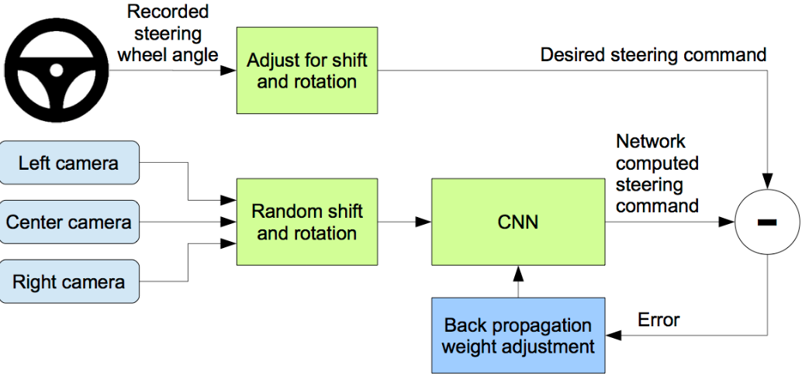
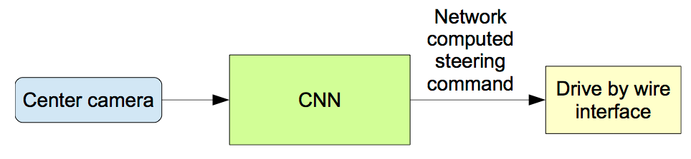
Software design
Images are fed into a CNN that then computes a proposed steering command. The proposed command is compared to the desired command for that image, and the weights of the CNN are adjusted to bring the CNN output closer to the desired output. The weight adjustment is accomplished using back propagation
Eventually, it generated steering commands using just a single camera

Slide 11
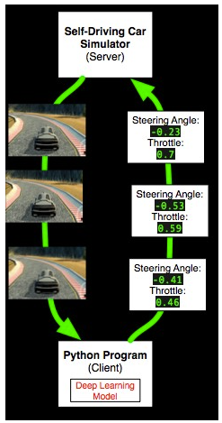
Testing
For testing we could sort of think as a server client architecture
The server is going to be the simulator itself that is our Udacity app and the client is the python program
We breakdown dataset into two parts one is for training and the other for testing
80% of the dataset is used for training
20% is used for testing
Training takes much time compared to testing
We will just run autonomous mode, then run our model and the car will start driving

Slide 12
CODE
Lets dive into training the model
The code displayed here is written in the file name model(model.py)
## IMPORTING LIBRARIES ##
#########################
import os
import csv
import cv2
import numpy as np
from PIL import Image
from keras.models import Sequential
from keras.layers import Flatten, Dense, Lambda
from keras.layers.core import Dense, Activation, Flatten, Dropout
from keras.layers import Cropping2D
from keras.layers.convolutional import Conv2D
from keras.layers.pooling import MaxPooling2D
from keras import backend as K
We import necessary libraries which we will be using later
Versions used:
H5py==2.7.1
Keras==2.1.6
Numpy==1.13.3
Opencv-python==3.3.0.10
Pandas==0.21.0
Tensorflow-gpu==1.10.1

Slide 13
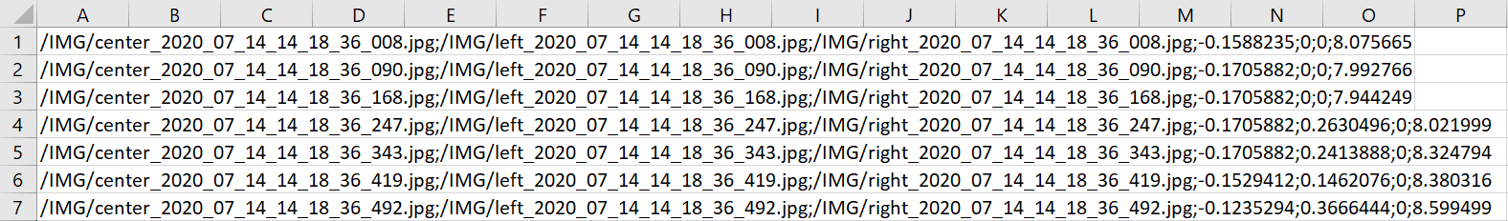
## READING IMAGE DATA FROM THE LOG ##
#####################################
lines = []
header = True
camera_images = []
steering_angles = []
with open('/content/driving_log.csv', 'r') as f:
reader = csv.reader(f, delimiter=';')
for row in reader:
if header:
header = False
continue
steering_center = float(row[3])
Now we will be reading the data column wise
As the data file is of format CSV we will open it and access via columns one by one
Which we can see in the following picture
First three columns are images captured by center , left , right cameras respectively
Next four columns are steering angle, throttle,reverse,speed respectively

Slide 14
#Steering angle (sa) correction factor for stereo cameras
sa_cor = 0.2
steering_left = steering_center + sa_cor
steering_right = steering_center - sa_cor
#Reading camera images from their paths
path_src1 = row[0]
path_src2 = row[1]
path_src3 = row[2]
img_name1 = path_src1.split('/')[-1]
img_name2 = path_src2.split('/')[-1]
img_name3 = path_src3.split('/')[-1]
path1 = '/content/data/IMG/' + img_name1
path2 = '/content/data/IMG/' + img_name2
path3 = '/content/data/IMG/' + img_name3
#Image and Steering Dataset
img_center = np.asarray(Image.open(path1))
img_left = np.asarray(Image.open(path2))
img_right = np.asarray(Image.open(path3))
camera_images.extend([img_center, img_left, img_right])
steering_angles.extend([steering_center, steering_left, steering_right])
We are accessing each and every image via Path which is stored in a zip file called data in which we have images captured(IMG) and CSV file(driving_log.csv)

Slide 15
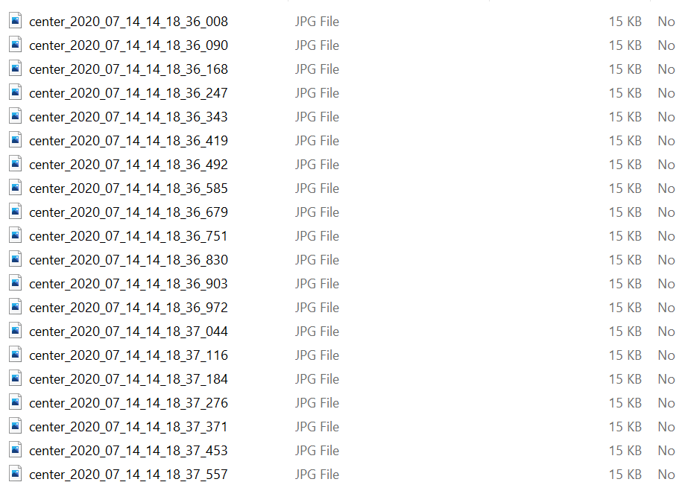
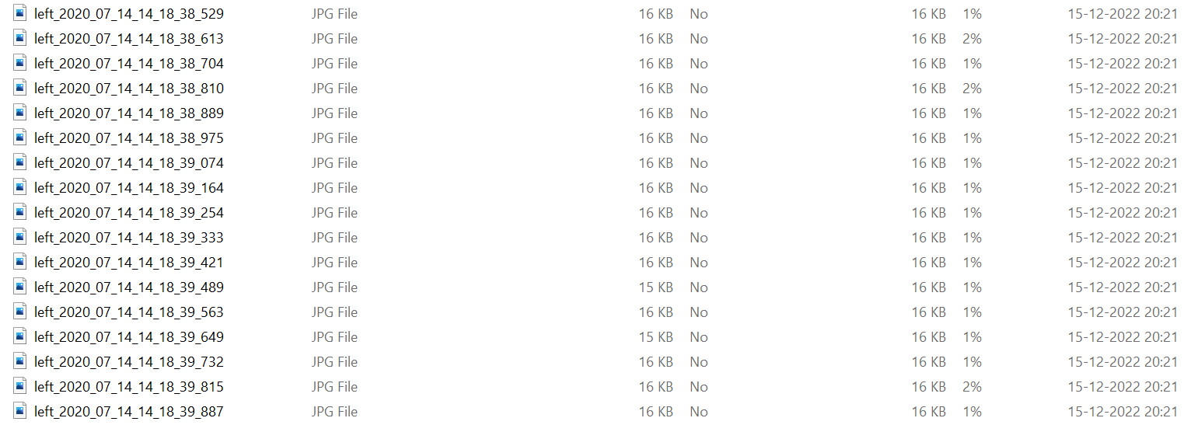
This is how Images had been stored while capturing in Data zip file

Slide 16
Data is augmented via this code
## DATA AUGMENTATION ##
#######################
augmented_imgs, augmented_sas= [],[]
for aug_img,aug_sa in zip(camera_images,steering_angles):
augmented_imgs.append(aug_img)
augmented_sas.append(aug_sa)
#Flipping the image
augmented_imgs.append(cv2.flip(aug_img,1))
#Reversing the steering angle
augmented_sas.append(aug_sa*-1.0)
## INDEPENDENT VARIABLES and LABELS ##
######################################
X_train, y_train = np.array(augmented_imgs), np.array(augmented_sas)
X_train, y_train = np.array(camera_images), np.array(steering_angles)
## IMAGE PRE-PROCESSING ##
##########################
def preprocess(image):
import tensorflow as tf
#Resizing the image
return tf.image.resize(image, (200, 66))
The images which are stored in zip file named Data are being processed using tensorflow GPU

Slide 17
## THE CNN ARCHITECTURE ##
##########################
'''
The CNN architecture is used from NVIDIA's End to End Learning for Self-Driving Cars paper.
Reference: https://arxiv.org/pdf/1604.07316v1.pdf
'''
#Keras Sequential Model
model = Sequential()
#Image cropping to get rid of the irrelevant parts of the image (the hood and the sky)
model.add(Cropping2D(cropping=((50,20), (0,0)), input_shape=(160,320,3)))
#Pre-Processing the image
model.add(Lambda(preprocess))
model.add(Lambda(lambda x: (x/ 127.0 - 1.0)))
We train the weights of our network to minimize the mean squared error between the steering command output by the network and the command of either the human driver, or the adjusted steering command for off-center and rotated images

Slide 18
#The layers
model.add(Conv2D(filters=24, kernel_size=(5, 5), strides=(2, 2),activation='relu'))
model.add(Conv2D(filters=36, kernel_size=(5, 5),strides=(2, 2), activation='relu'))
model.add(Conv2D(filters=48, kernel_size=(5, 5), strides=(2, 2),activation='relu'))
model.add(Conv2D(filters=64, kernel_size=(3, 3) ,activation='relu'))
model.add(Conv2D(filters=64, kernel_size=(3, 3),activation='relu'))
model.add(Dropout(0.5))
model.add(Flatten())
model.add(Dense(units=100, activation='relu'))
model.add(Dense(units=50, activation='relu'))
model.add(Dense(units=10, activation='relu'))
model.add(Dense(units=1))
print(model.summary())
The network consists of 9 layers, including a normalization layer, 5 convolutional layers and 3 fully connected layers. The input image is split into YUV planes and passed to the network. The first layer of the network performs image normalization. The normalizer is hard-coded and is not adjusted in the learning process. Performing normalization in the network allows the normalization scheme to be altered with the network architecture and to be accelerated via GPU processing. The convolutional layers were designed to perform feature extraction and were chosen empirically through a series of experiments that varied layer configurations.
We use strided convolutions in the first three convolutional layers with a 2×2 stride and a 5×5 kernel and a non-strided convolution with a 3×3 kernel size in the last two convolutional layers

Slide 19
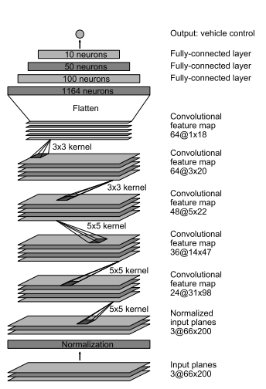
We follow the five convolutional layers with three fully connected layers leading to an output control value which is the inverse turning radius. The fully connected layers are designed to function as a controller for steering, but we note that by training the system end-to-end, it is not possible to make a clean break between which parts of the network function primarily as feature extractor and which serve as controller.

Slide 20
#Compiling and Saving the Model
model.compile(loss='mse',optimizer='adam') #adaptive moment estimation.
model.fit(X_train,y_train,validation_split=0.2,shuffle=True,epochs=10)
model.save('model.h5')
print('The model.h5 file has been created!')
## END OF THE CODE ##
The training code which is model.py is executed in google colab as !python model.py
Now the model has been saved into model.h5 file which we will be using for testing
In next slide we have the outputs of training code once executed

Slide 21
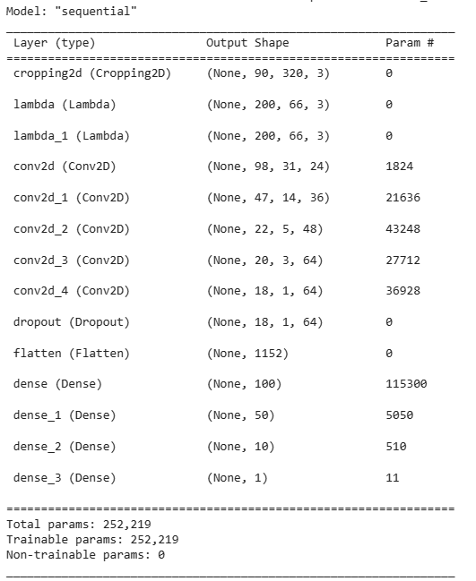
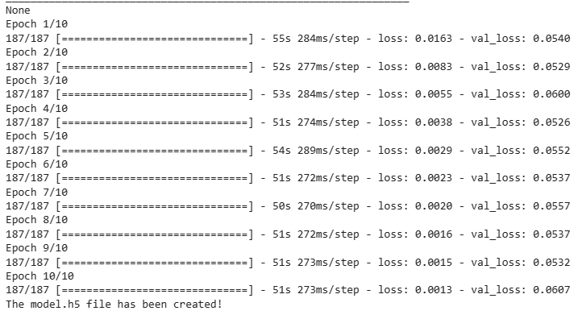

Slide 22
Lets dive into testing the model
The code displayed here is written in the file name drive(drive.py)
import argparse
import base64
from datetime import datetime
import os
import shutil
import numpy as np
import socketio
import eventlet
import eventlet.wsgi
from PIL import Image
from flask import Flask
from io import BytesIO
from keras.models import load_model
import h5py
from keras import __version__ as keras_version
We import necessary libraries which we will be using later
Versions used:
H5py==2.7.1
Keras==2.1.6
Numpy==1.13.3
Opencv-python==3.3.0.10
Pandas==0.21.0
Tensorflow-gpu==1.10.1
Matplotlib==2.1.0
Flask-SocketIO==2.9.2
Eventlet==0.21.0

Slide 23
sio = socketio.Server()
app = Flask(__name__)
model = None
prev_image_array = None
class SimplePIController:
def __init__(self, Kp, Ki):
self.Kp = Kp
self.Ki = Ki
self.set_point = 0.
self.error = 0.
self.integral = 0.
def set_desired(self, desired):
self.set_point = desired
def update(self, measurement):
# proportional error
self.error = self.set_point - measurement
# integral error
self.integral += self.error
return self.Kp * self.error + self.Ki * self.integral
controller = SimplePIController(0.1, 0.002)
set_speed = 9
controller.set_desired(set_speed)

Slide 24
@sio.on('telemetry')
def telemetry(sid, data):
if data:
# The current steering angle of the car
steering_angle = data["steering_angle"]
# The current throttle of the car
throttle = data["throttle"]
# The current speed of the car
speed = data["speed"]
# The current image from the center camera of the car
imgString = data["image"]
image = Image.open(BytesIO(base64.b64decode(imgString)))
image_array = np.asarray(image)
steering_angle = float(model.predict(image_array[None, :, :, :], batch_size=1))
throttle = controller.update(float(speed))
print(steering_angle, throttle)
send_control(steering_angle, throttle)
# save frame
if args.image_folder != '':
timestamp = datetime.utcnow().strftime('%Y_%m_%d_%H_%M_%S_%f')[:-3]
image_filename = os.path.join(args.image_folder, timestamp)
image.save('{}.jpg'.format(image_filename))
else:
# NOTE: DON'T EDIT THIS.
sio.emit('manual', data={}, skip_sid=True)

Slide 25
@sio.on('connect')
def connect(sid, environ):
print("connect ", sid)
send_control(0, 0)
def send_control(steering_angle, throttle):
sio.emit(
"steer",
data={
'steering_angle': steering_angle.__str__(),
'throttle': throttle.__str__()
},
skip_sid=True)

Slide 26
if __name__ == '__main__':
parser = argparse.ArgumentParser(description='Remote Driving')
parser.add_argument(
'model',
type=str,
help='/content/model.h5'
)
parser.add_argument(
'image_folder',
type=str,
nargs='?',
default='',
help='/content/img.zip'
)
args = parser.parse_args()
# check that model Keras version is same as local Keras version
f = h5py.File(args.model, mode='r')
model_version = f.attrs.get('keras_version')
keras_version = str(keras_version).encode('utf8')
if model_version != keras_version:
print('You are using Keras version ', keras_version,
', but the model was built using ', model_version)
model = load_model(args.model)
if args.image_folder != '':
print("Creating image folder at {}".format(args.image_folder))
if not os.path.exists(args.image_folder):
os.makedirs(args.image_folder)
else:
shutil.rmtree(args.image_folder)
os.makedirs(args.image_folder)
print("RECORDING THIS RUN ...")
else:
print("NOT RECORDING THIS RUN ...")
# wrap Flask application with engineio's middleware
app = socketio.Middleware(sio, app)
# deploy as an eventlet WSGI server
eventlet.wsgi.server(eventlet.listen(('', 4567)), app)

Slide 27
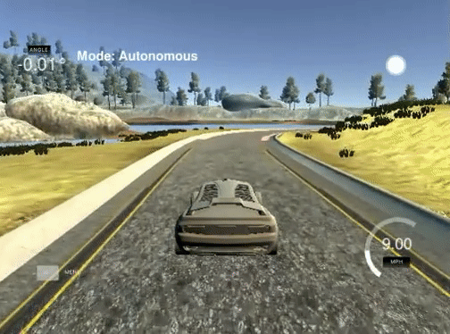
The testing code which is drive.py is executed in google colab along with model.h5 which is our trained model as !python drive.py model.h5
Before executing the code we have to open the beta simulator and then select the mode as autonomous , then run the above command, we can see that the car is moving accordingly
Car in autonomous mode driving one lap

Slide 28
CONCLUSION
The testing has been done successfully using 7467 (2488 images per camera) images recorded
Car drives almost perfect (as we have trained it using the data it may not always predict accurately)
In this project, only the steering angle is added as a dependent variable (label) for the corresponding camera images. However, it can be understood that this alone is not sufficient, because the autonomous mode driving speed is low, and that the vehicle wobbles around the center line during turns. At this point, speed and braking data can also be added to the model to train a driving behavior that can make smoother turns. And we can also train the model to follow certain traffic rules too

Slide 29
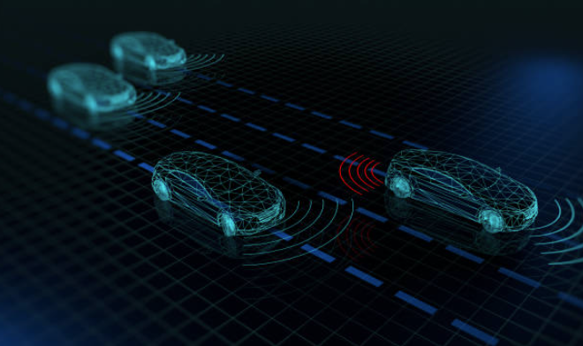
THANK YOU

